Slide 1
Metrash2 HOW TO APPLY FOR FAMILY VISIT VISA
November 2019

Slide 2
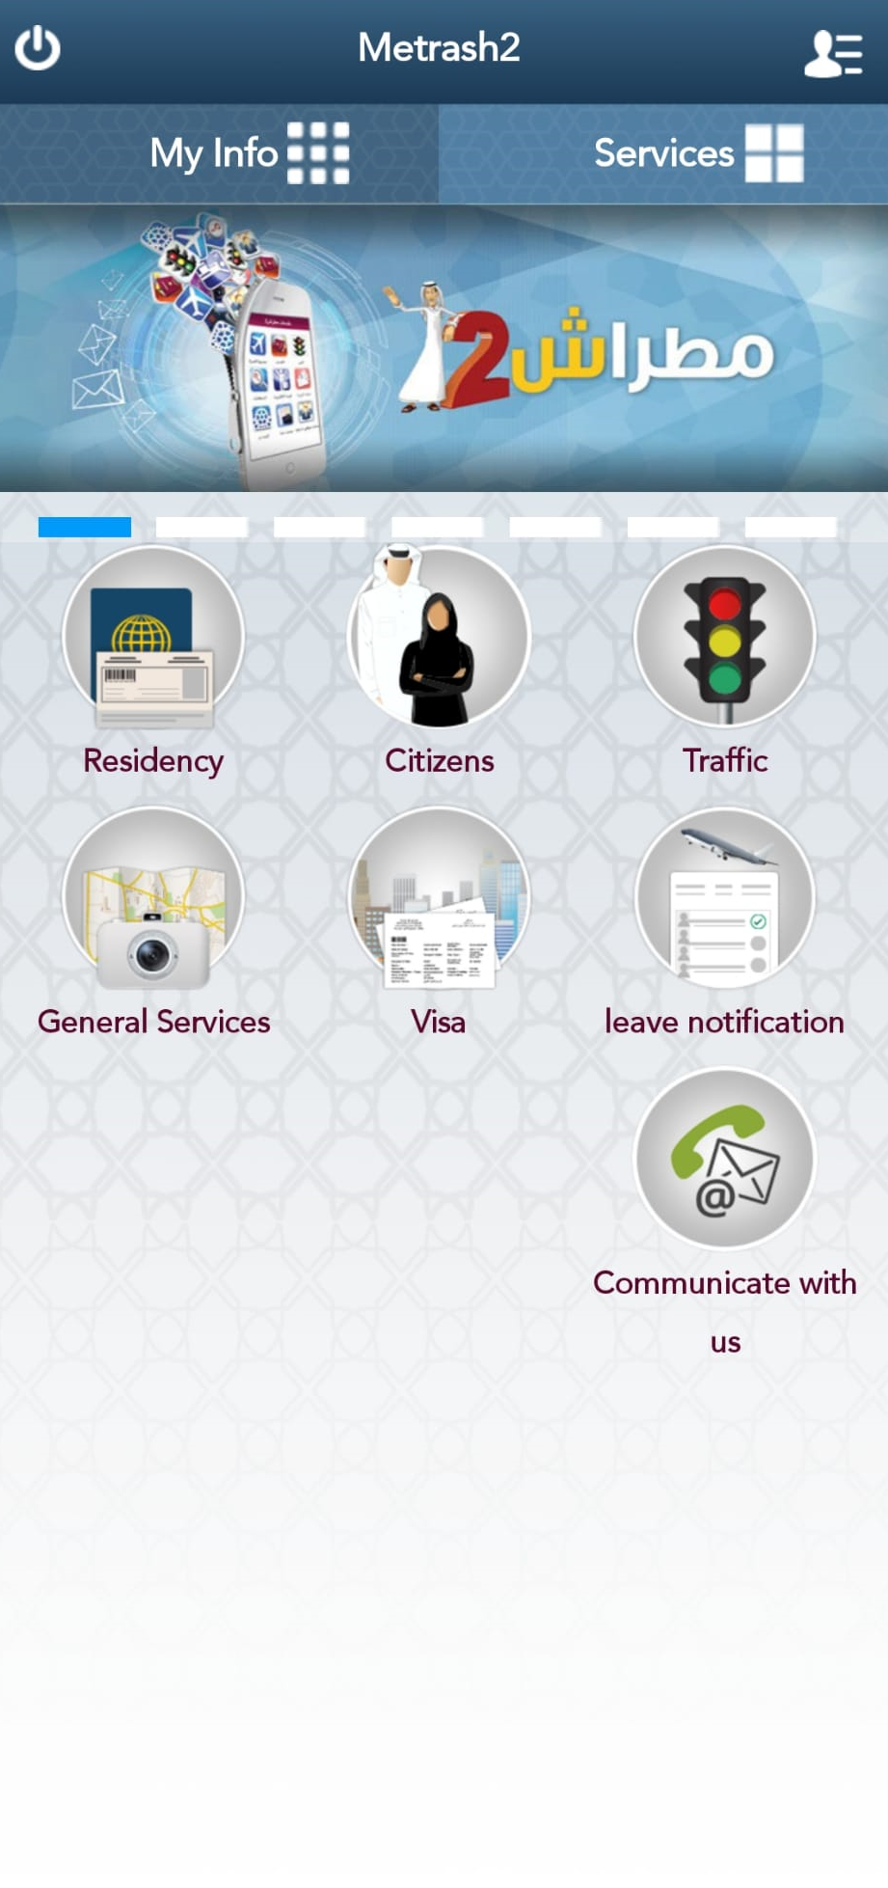
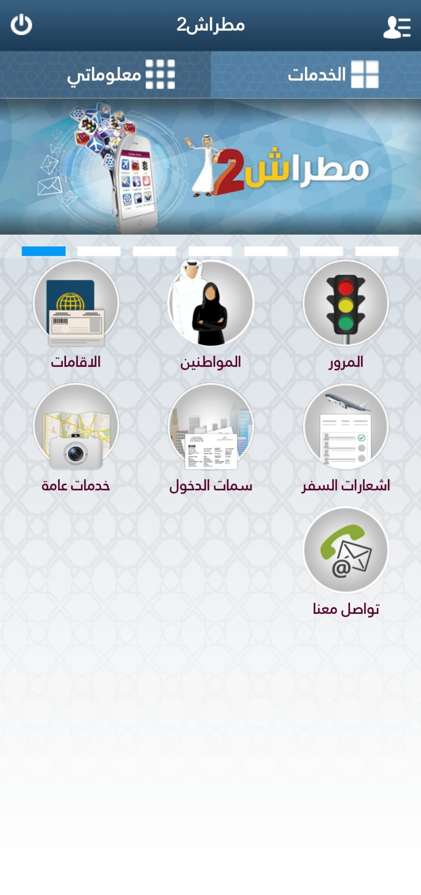
1. Select Visa.

Slide 3
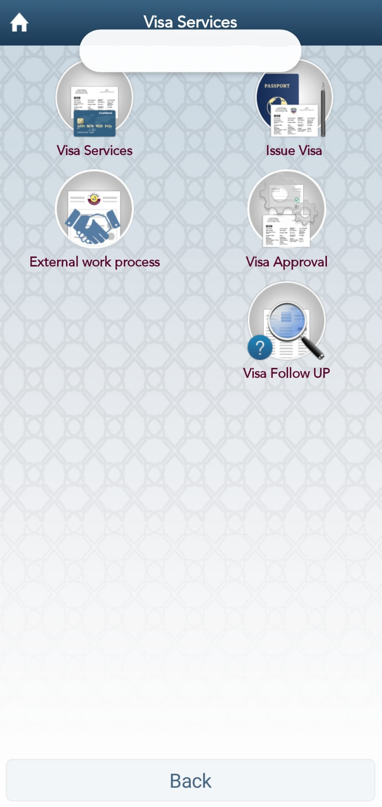
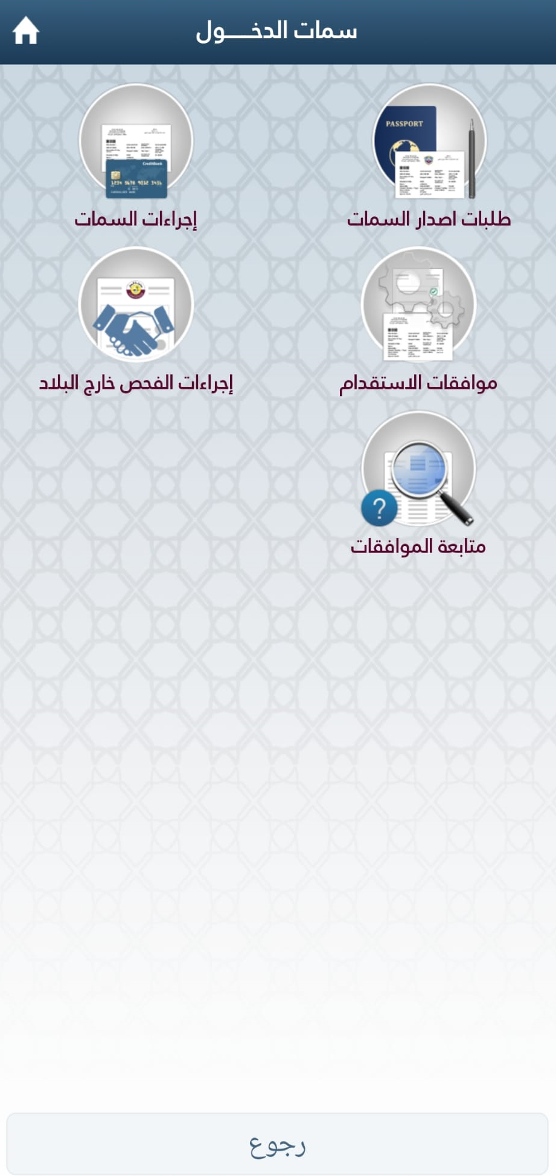
2. Select Issue Visa.

Slide 4
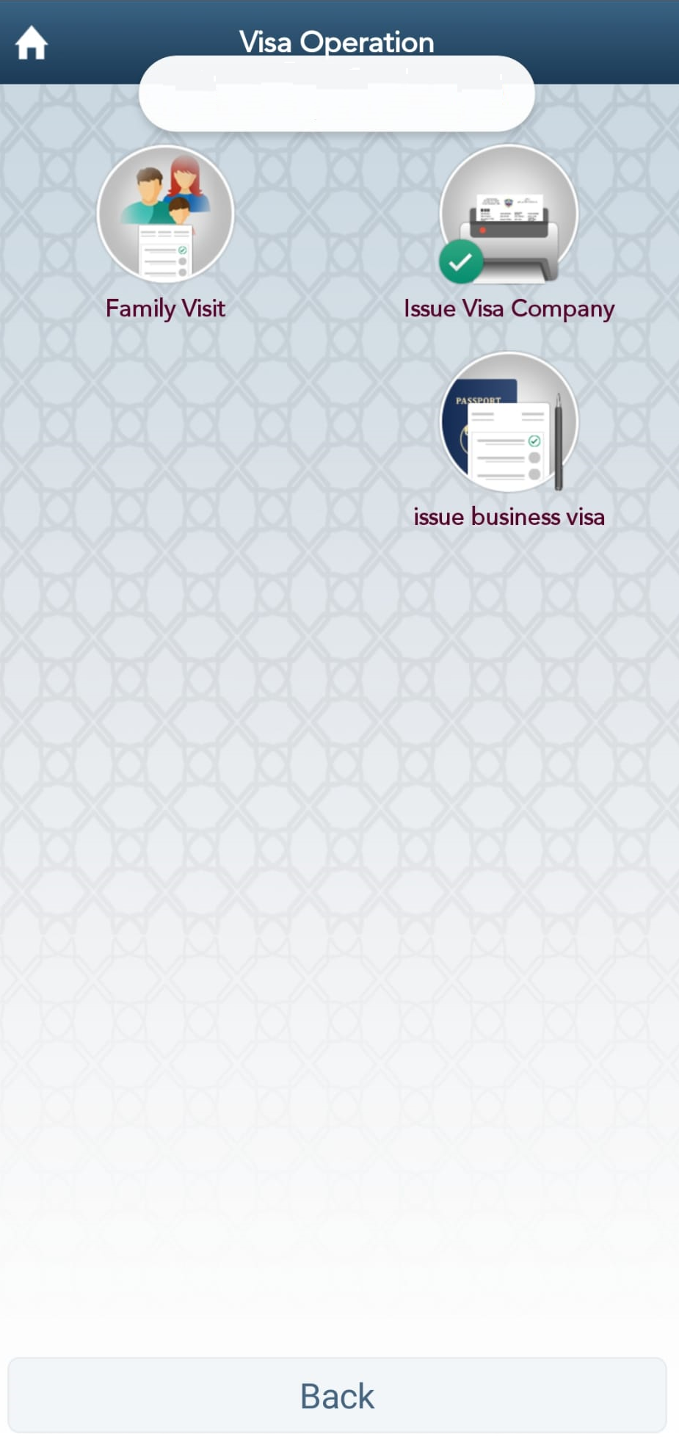
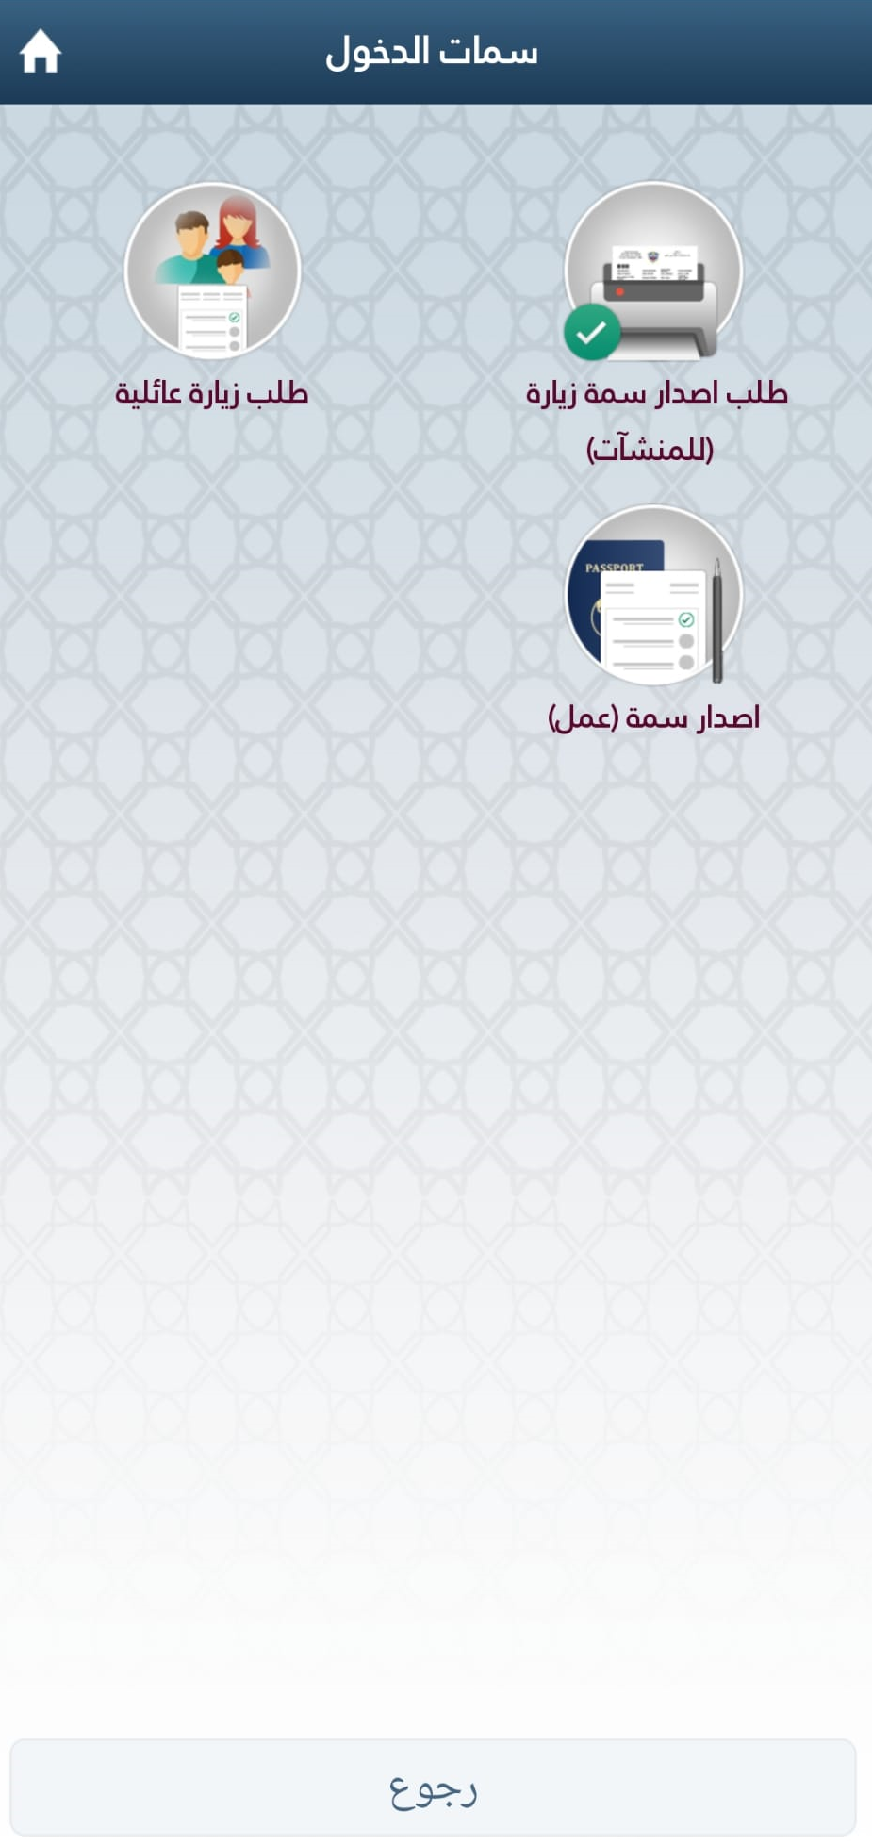
3. Select Family Visit.

Slide 5
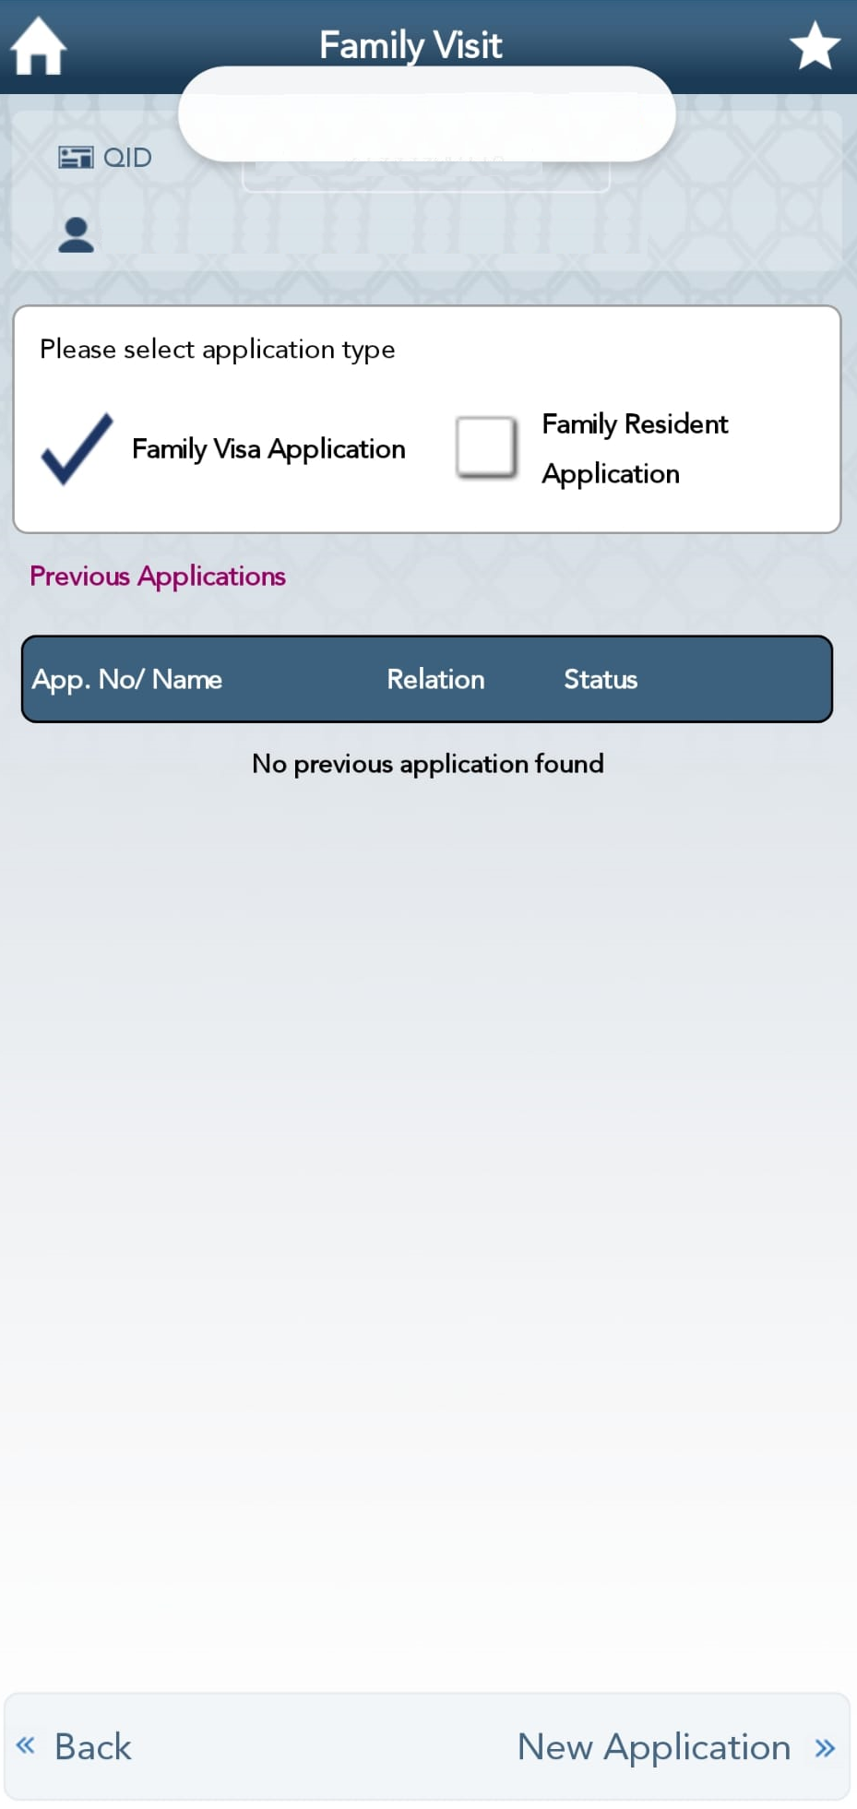
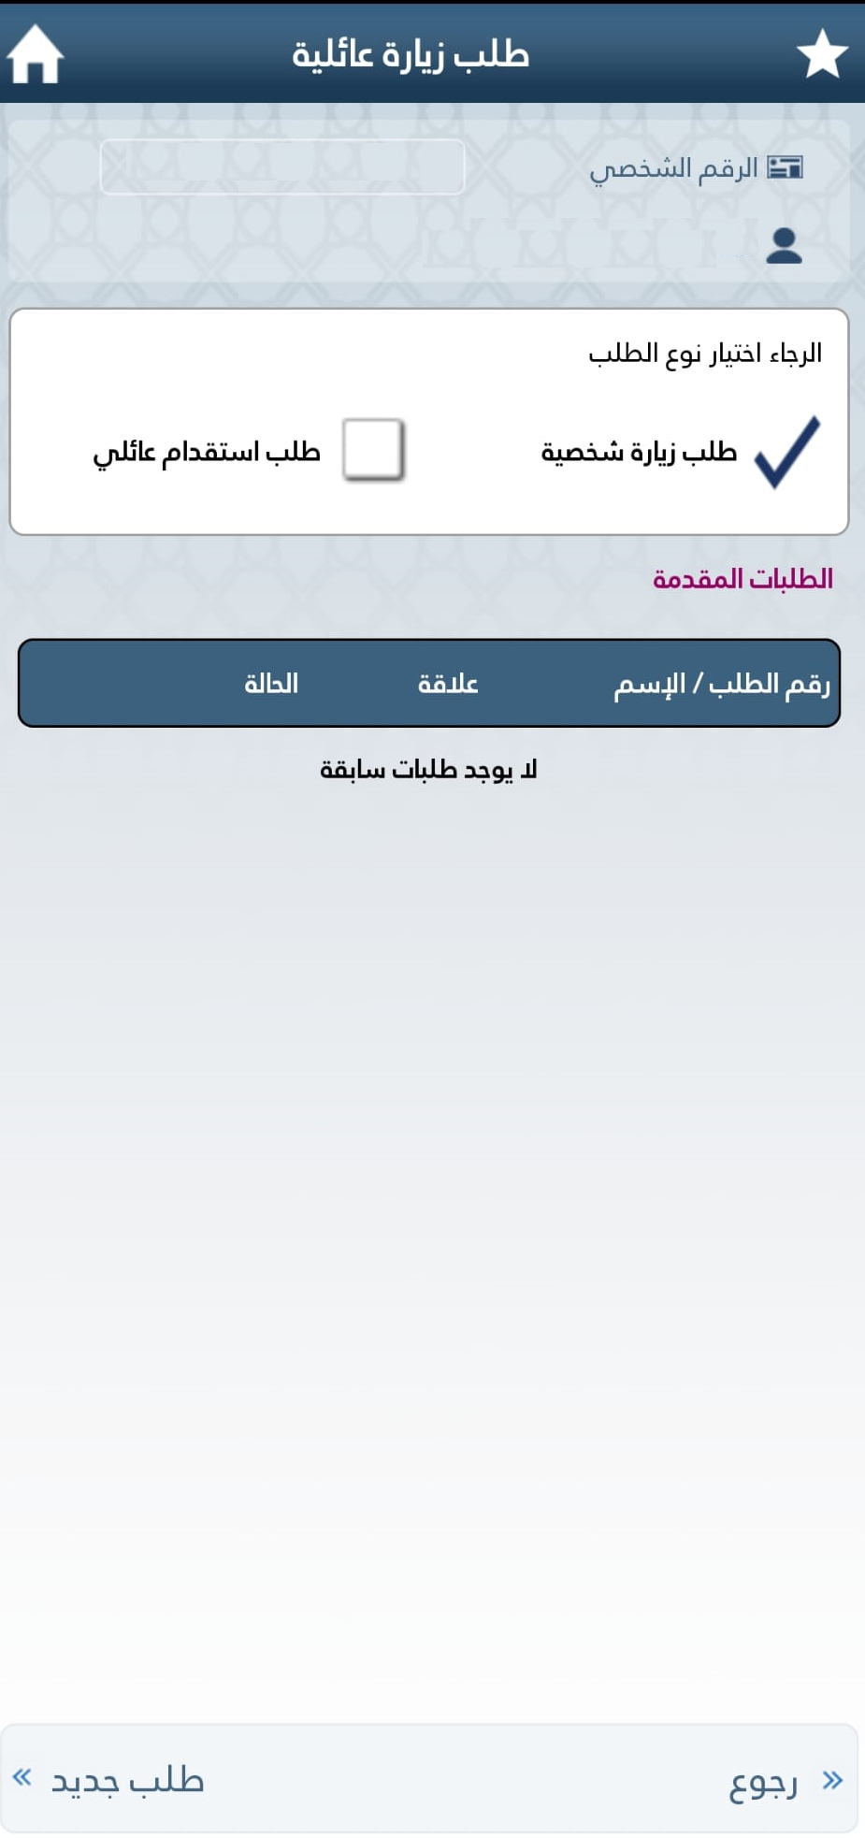
4. Select Family Visa Application tick box and then select New Application.

Slide 6
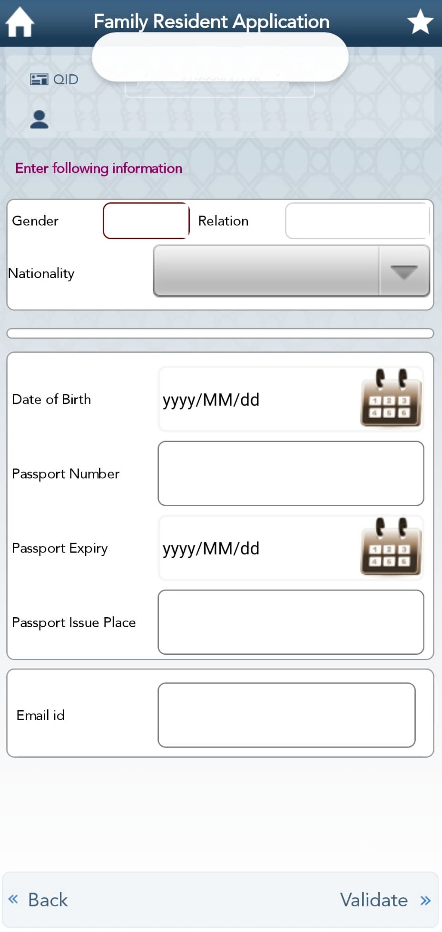
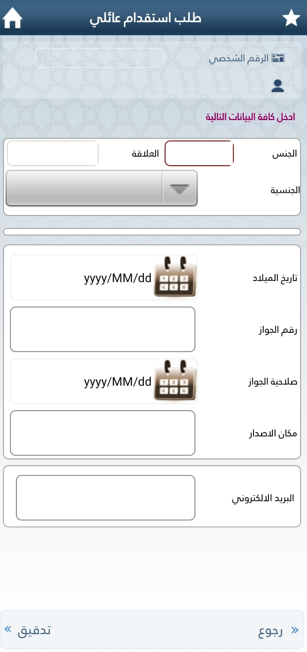
5. Complete the form and select VALIDATE and then in the next page, attach the supporting documentations.

