Slide 1
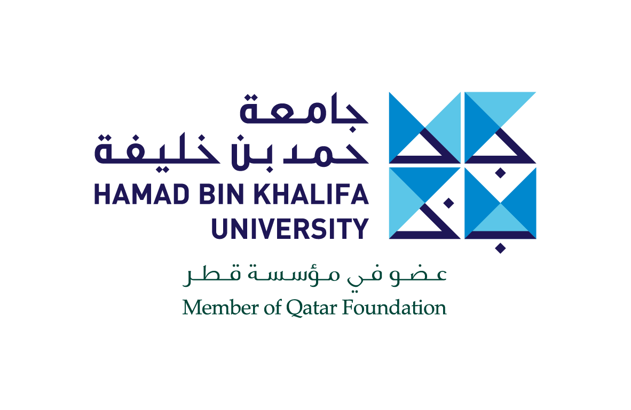


Slide 2
Hamad Bin Khalifa University
Innovating Today, Shaping Tomorrow
Hamad Bin Khalifa University (HBKU), a member of Qatar Foundation for Education, Science, and Community Development (QF), was founded in 2010 as a research-intensive university that acts as a catalyst for transformative change in Qatar and the region while making global impact. HBKU, located in Education City, is committed to building and cultivating human capacity through an enriching academic experience, innovative ecosystem, and unique partnerships.
HBKU delivers multidisciplinary undergraduate and graduate programs through its colleges,
and provides opportunities for research and scholarship through its institutes and centers.
For more information about HBKU, visit www.hbku.edu.qa.

Slide 3
Vision
To be an innovation-based, entrepreneurial university leading in education and research,
and solving the critical challenges facing Qatar and the world.
Mission
HBKU develops world-class, integrated academic programs, and national research capabilities that drive collaboration with the world’s best institutions, cultivating leaders for the future, propelling Qatar’s knowledge-based economy, and shaping novel solutions for global impact.
Innovating Today, Shaping Tomorrow
HBKU is driven to fulfil QF’s vision of unlocking human potential. HBKU is a research-intensive university that acts as a catalyst for transformative change in Qatar and the region while making a global impact.
HBKU provides unparalleled opportunities for inquiry and discovery. Both are integral to teaching and learning at all levels, and HBKU programs adopt a multidisciplinary approach across all focus areas.
HBKU is committed to building and cultivating human capacity through an enriching academic experience and an innovative research ecosystem. By applying creativity to knowledge, students will have the opportunity to discover innovative solutions that are locally relevant
and have a global impact. At HBKU, our students, faculty, staff, partners, and leadership, all share a common belief in the power of higher education and research to make a positive impact on the development of nations.

Slide 4
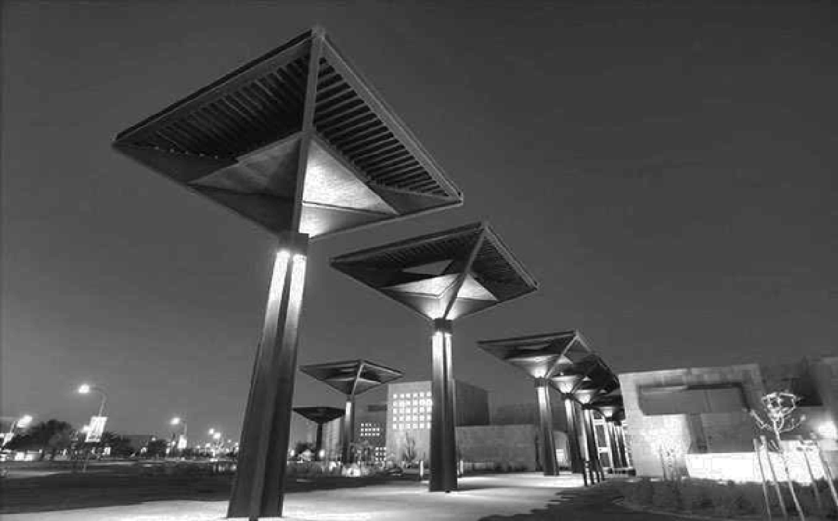
PILLARS
Excellence
Recognition of Quality Through Achievements
People
Shaping Society
Partners
Success Through Synergy
Innovation
Leading Transformation

Slide 5
KEY POSITIONING STATEMENT
Hamad Bin Khalifa University pursues excellence in education and research to foster innovation that transforms Qatar and impacts the world.
Key Messages | Descriptive Statements
Pursuing Excellence in Education and Research | HBKU strives to create a teaching and research environment that helps students address critical challenges of tomorrow, and enables faculty and researchers to achieve their intended impact.
Shaping Leaders of Tomorrow | HBKU nurtures a culture where people play an active role in effecting positive change in the wider global community. Students at HBKU gain critical skills relevant to their field and are immersed in an environment that promotes continuous learning and self-development. Externally, HBKU plays a role in developing leaders of all ages and in all sectors.
Fostering Transformative Innovation | HBKU is built on a spirit of innovation, inspiring its students, faculty, and researchers to work towards discovering innovative solutions that respond to regional and global challenges. HBKU will play an advocacy role for innovation in Qatar and the region, building bridges with relevant stakeholders.
Harnessing the Power of Synergies | HBKU actively leverages synergies with local and international partners and organizations to ensure a high-quality research and education ecosystem.

Slide 6
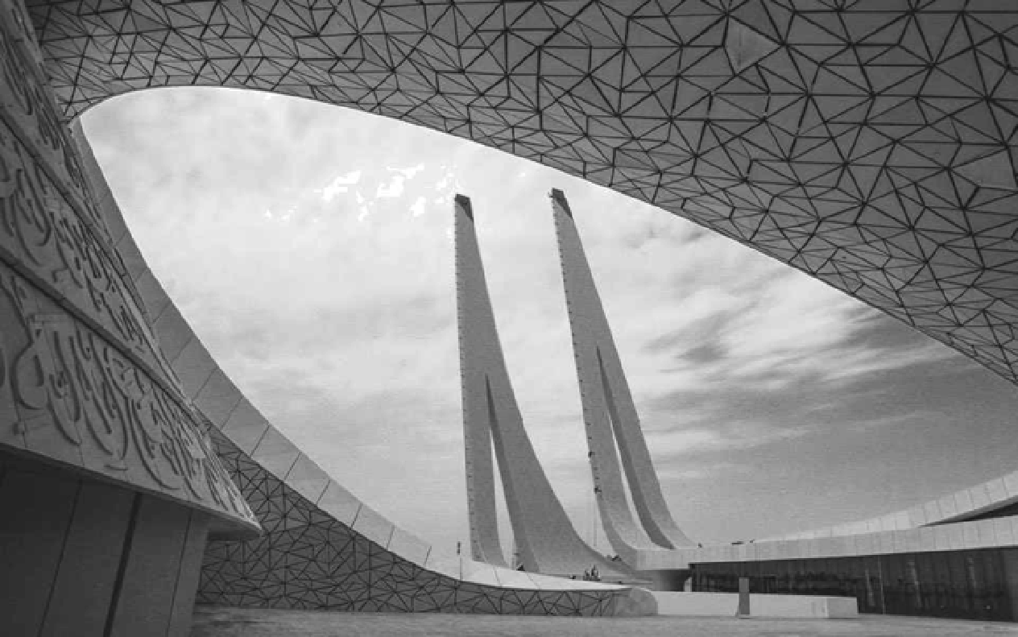
STRATEGIC OBJECTIVES
Be a top-ranked, widely recognized, research-based university
Develop leaders through programs that are aligned to the future needs of Qatar and the world
Be a national resource of knowledge, serving government, industry and society in Qatar by leveraging synergies with partners and other organizations to ensure a high quality research and education environment
Conduct high-impact research that provides solutions to challenges that are critical to Qatar and the world

Slide 7

ENTITIES
Colleges
Research Institutes
Centers
College of Islamic Studies (CIS)
Qatar Environment and Energy Research Institute (QEERI)
HBKU Executive Education Center (EEC)
College of Humanities
and Social Sciences (CHSS)
Qatar Computing
Research Institute (QCRI)
HBKU Press
College of Science
and Engineering (CSE)
Qatar Biomedical
Research Institute (QBRI)
College of Law (CL)
College of Health
and Life Sciences (CHLS)
College of Public Policy (CPP)

Slide 8
ACADEMIC ACHIEVEMENTS
New Programs
In an expansion that reflected Hamad Bin Khalifa University’s growth as a higher learning institution and bolstered its position as a leading destination for postgraduate education
in Qatar and the region, the University announced the launch of eight new academic degrees
in 2019 across six colleges. The new degrees include the Master of Arts (MA) in Applied Islamic Ethics; Doctor of Philosophy (PhD) in Humanities and Social Sciences; Master of Science (MS)
in Information Systems for Health Management; Master of Science (MS) in Sports Management (joint degree with the University of South Carolina); LLM in International Law and Foreign Affairs; LLM in International Economic and Business Law; Master of Science (MS) in Exercise Science (joint degree with the University of South Carolina); and Master of Public Policy.
Graduation of CHSS’ First Cohorts in Digital Humanities and Societies and Women,
Society and Development
The college’s Master of Arts in Digital Humanities and Societies and Master of Arts in Women, Society and Development graduated their first cohorts on May 4 and are two programs
that directly address the ever-changing digital landscape and evolving role of women in the Arab world.
Graduation of CSE’s First Cohorts in Computer Engineering, Sustainable Energy, and Sustainable Environment
Students comprising the first cohorts of three programs in computer engineering, sustainable energy, and sustainable environment graduated on May 4 armed with the knowledge and skills to tackle national challenges and make lasting contributions in their chosen fields.
Graduation of CHLS’ First Cohorts in Biological and Biomedical Sciences and Genomics
and Precision Medicine
On May 4, the college celebrated the graduation of its first batches of students who were enrolled in the PhD in Biological and Biomedical Sciences and MS in Genomics and Precision Medicine programs.

Slide 9
LEVERAGING PARTNERSHIPS
Hamad Bin Khalifa University strives to build a unique ecosystem that supports the delivery
of high quality academic programs as well as research activities. With the pursuit of mutually-advantageous partnerships tied into the institution’s core value pillars, the University is committed to building synergies with key local and international entities in line with its objectives of providing high-quality student learning opportunities. As such, the University’s colleges, research institutes, and centers are firmly positioned within a strong network of local and international partners within a host of various industries, such as aerospace; airlines; construction; communications, engineering; education; energy; non-profit foundations; gas
and oil; government; healthcare; law; and technology.
Some of Hamad Bin Khalifa University’s newly formed partnerships around the world include edX, Al-Farabi Kazakh National University, Imagine Institute, Nizwa University, King Hussein Cancer Center, Harvard University, Al Jamia Al Islamiya, and the Islamic University of Applied Science Rotterdam.
Locally, Hamad Bin Khalifa University continues to strengthen collaborations with key stakeholders such as the Ministry of Development Planning and Statistics, Sidra Medicine, ExxonMobil, Qatar Diabetes Association, and Hamad Medical Corporation.
These synergies allow for an exchange of knowledge, student learning opportunities, and
the expansion of shared research and development programs.

Slide 10
ACADEMIC PROGRAMS
College of Islamic Studies PhD in Islamic Finance and Economy Master of Arts in Applied Islamic Ethics Master of Arts in Islamic Studies Master of Arts in Islam and Global Affairs Master of Science in Islamic Art, Architecture and Urbanism Master of Science in Islamic Finance College of Humanities and Social Sciences PhD in Humanities and Social Sciences Master of Arts in Translation Studies Master of Arts in Audiovisual Translation Master of Arts in Women, Society and Development Master of Arts in Digital Humanities and Societies Master of Arts in Intercultural Communication College of Science and Engineering Master of Science in Sport and Entertainment Management Master of Information Systems in Health Management PhD in Computer Science and Engineering PhD in Sustainable Energy PhD in Sustainable Environment PhD in Logistics and Supply Chain Management Master of Science in Sustainable Energy Master of Science in Sustainable Environment Master of Science in Cybersecurity Master of Science in Data Science and Engineering Master of Science in Logistics and Supply Chain Management Master of Data Analytics in Health Management Bachelor of Science in Computer Engineering Executive Master in Energy and Resources College of Law Doctor of Juridical Science (SJD) Juris Doctor (JD) LLM in International Law and Foreign Affairs LLM in International Economic and Business Law College of Health and Life Sciences PhD in Genomics and Precision Medicine PhD in Biological and Biomedical Sciences Master of Science in Genomics and Precision Medicine Master of Science in Biological and Biomedical Sciences Master of Science in Exercise Science College of Public Policy Master of Public Policy

Slide 11
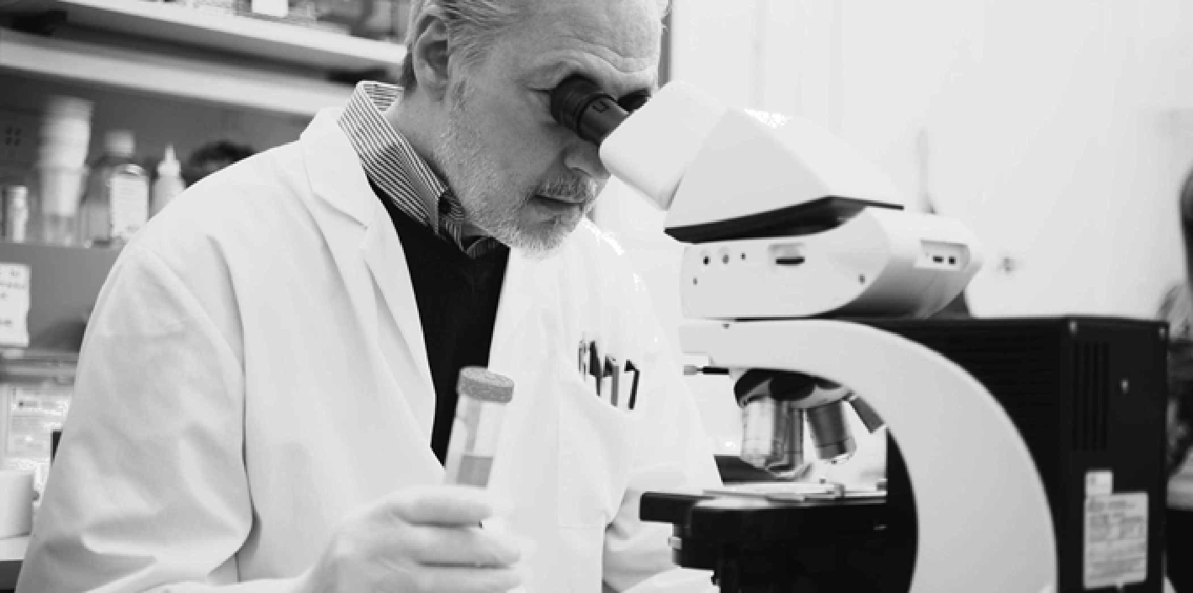
HBKU RESEARCH THEMES
Energy Security: Energy efficiency, oil and gas, renewable energy
Water Security: Desalination and waste, water reuse capabilities
Environment: Environmental sustainability, climate change
Cybersecurity: Computing and data analytics, cryptography, and network security
Health Sciences: Cancer, diabetes, neurological disorders, genomics and precision medicine
Humanities and Social Sciences: Translation, Middle Eastern studies
Islamic Studies: Islamic finance, Islamic ethics and legislation, Islamic renewal
Law and Public Policy: Corporate governance, public policy and administration
with sectoral focus

Slide 12
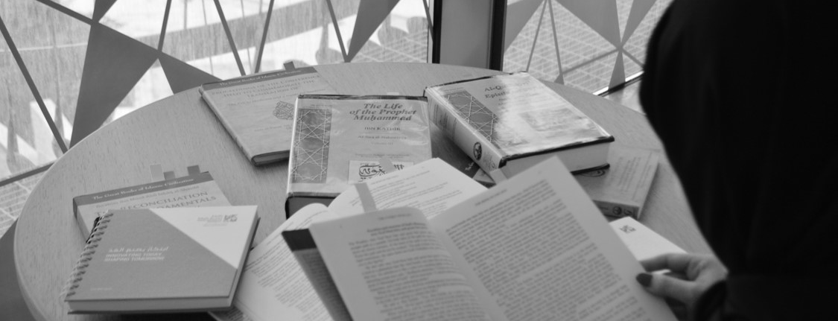
INSIDE HBKU’S COLLEGES:
College of Islamic Studies
The College of Islamic Studies (CIS) serves as a hub for contemporary Islamic studies where top caliber faculty and students engage in open dialogue and exchange thoughts and ideas concerning Islam and Muslims.
In 2018, the College enjoyed growing success, graduating 126 master’s students and expanding its academic portfolio with the addition of two new master’s programs (Master of Arts in Islam and Global Affairs and Master
of Science in Islamic Art, Architecture and Urbanism) and a new doctoral degree (PhD in Islamic Finance and Economy).
CIS, along with its partners, participates in a wide range of activities locally and internationally each year, including public lectures, workshops and outreach activities. For instance, during the academic year 2017-2018, its renowned faculty made over 30 public lecture appearances at some of the world’s most prestigious educational institutions, lending its expertise on the multifaceted domain of Islamic studies to fellow researchers and academics. Likewise, broadening its engagement with key global institutions and partners, the College recently signed Memoranda of Understanding with the University of Notre Dame, Qatar Financial Centre, Museum of Islamic Art, India’s Al Jamia Al Islamia, and Turkey’s Sabahattin Zaim and Ibn Haldun universities. CIS also reactivated its University of Oxford agreement, and signed an agreement with Caux Round Table for Moral Capitalism for collaborative access to historical resources in Vatican City.
Collectively, the College’s faculty has had 30 papers presented at various conferences, and 18 featured in peer-reviewed journals. Furthermore, during the past year, CIS brought highly distinguished guests to share a panel on renowned thought-leader Malek Bennabi as a prelude to a two-day exploration of his works on the revitalization of Muslim societies. The College’s locally organized symposia and roundtables have featured leading authorities in the field of Islamic economics and finance, such as the Governor of Qatar Central Bank, the CEO of Qatar Development Bank, and Qatar Financial Centre Authority. Together, they have highlighted the centrality of scientific development as part of the preservation of religious identity.
The College’s student body similarly participates in ongoing academic discourse with nine students presenting their research work at various international conferences in 2018. Furthermore, a CIS student formed part of group of young leaders selected to represent the Qatar team at Silicon Valley, a United States center for tech start-ups and global technology companies. Additionally, 50 students participated in a number of entrepreneurial activities in the country, with six alumni going on to launch their own startup business after graduation.

Slide 13
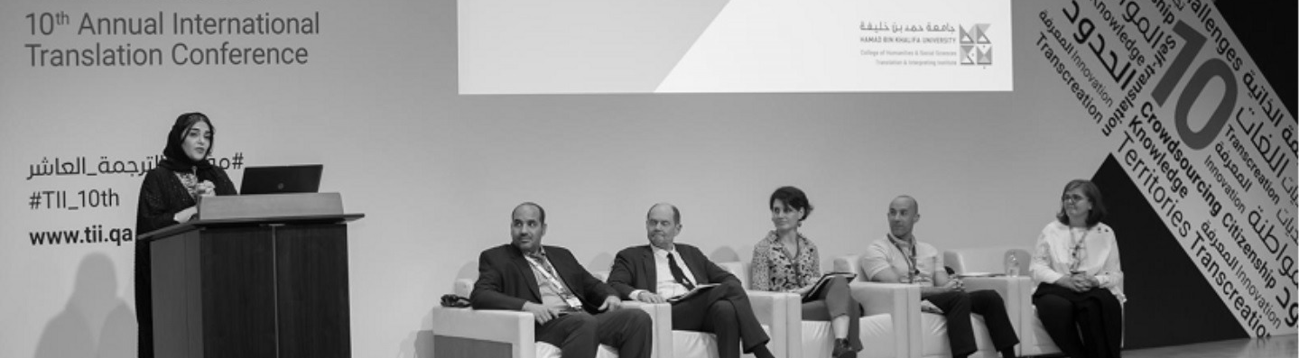
INSIDE HBKU’S COLLEGES:
College of Humanities and Social Sciences
The College of Humanities and Social Sciences (CHSS) offers innovative, interdisciplinary, research-intensive postgraduate programs that prepare full-time students for academic and professional pursuits.
In the 2018-2019 academic year, 27 students graduated from CHSS, 85 percent of whom were female and 52 percent of which were Qataris. The graduates joined a pool of over 70 CHSS alumni. Additionally, CHSS faculty members published 14 works, including six peer-reviewed articles, two encyclopedia entries, one book, and contributed to four book chapters.
CHSS students have had the opportunity to showcase their research at many prestigious international conferences, including the DAKAM Conference for Middle Eastern Studies in Turkey, the 5th World Congress for Middle Eastern Studies Conference in Spain, and the 20th international Conference on Arts, Humanities and Social Sciences in Portugal.
Meanwhile, locally, graduate students have interned with the nation’s preeminent organizations: ELAN, Qatar Business Incubation Centre, National Human Rights Committee, Qatar Museums Authority, Qatar Tourism Authority, Qatar National Library, and Qatar Science & Technology Park.
The College is also home to the Translation and Interpreting Institute (TII), which delivers two MA programs in translation and interpreting studies. TII is also home to the Language Center (LC) and the Translation and Training Center (TTC).
In addition to delivering two unique academic programs, TII’s scholastic events attract impressive numbers of scholars and public patrons. For instance, more than 40 speakers from 16 countries attended the 10th Translation and Interpreting Institute International Conference. TII hosted more than 300 delegates during the conference, and was amongst the top trending topics locally on Twitter.
Via the Translation and Training Center (TCC), TII provides translation and interpreting services to a number of leading local institutions, including Doha Film Institute, the Supreme Committee for Delivery and Legacy, Ministry of Justice, Sidra Medicine, Qatar Foundation, Msheireb Properties, Research Center for Islamic Legislation & Ethics (CILE), Qatar Philharmonic Orchestra, World Innovation Summit for Education (WISE), and the World Innovation Summit for Health (WISH).
In 2018, TII’s TTC hosted numerous workshops, language courses and training, which were open to the community. In addition, the growing range of foreign language courses on offer at TII’s Language Center (LC) today include Arabic, French, German, Italian, Mandarin Chinese, Portuguese, Turkish, Russian and Spanish. This past year, a total of 355 children enrolled in TII’s Language Center programs and 544 in the adult programs. In Spring 2019, the Language Center increased its student intake by 12.8 percent compared to Spring 2018.
TII’s Arabic language education program holds paramount relevance in the country considering its contribution to the preservation and protection of the language. The College regularly conducts language training for institutes in Qatar. Most recently, TII trained 31 staff members at Sidra Medicine in basic Arabic language skills. A further 19 staff members enrolled in the Basic Arabic for Clinical/Medical course; and 13 patient-facing staff members took the Basic Arabic for Non-Medical course.

Slide 14

INSIDE HBKU’S COLLEGES:
College of Science and Engineering
The College of Science and Engineering (CSE) is a world-class multi-disciplinary college whose educational and research curricula carries significant positive impact on Qatar, the region and the globe, in the fields of science, engineering, and technology. Its faculty, staff and students have excelled as thought-leaders and have implemented and contributed to novel research, which is published in a number of leading research-driven local, regional and international conferences and journals.
The College’s faculty – who represent more than 16 nationalities, and have collectively amassed more than 100,000 lifetime citations – are all previously associated with top-ranking universities, such as Massachusetts Institute of Technology (MIT), Stanford, the University of Southern California, the University of Pittsburgh, the University of Michigan, McGill University, Texas A&M University, and the University of Maryland. The College’s student body similarly hails from a diverse range of backgrounds and represent over 20 nationalities. Comprising over 300 graduate students last year, 22 bachelor’s students, 44 master’s students, and 74 PhD students were notably Qataris. In particular, the number of applications and the quality of applicants to the College have progressively increased every year since the founding of the College, which is an indication of the excellent reputation CSE has been building over the years.
During the past academic year, the faculty members’ – a body that includes four international research fellows and 27 joint appointments with the University’s research institutes – collective efforts culminated in 350 peer-reviewed scientific publications (at the rate of 8 publications per faculty member every year) and having 22 active research grants. They also submitted 10 provisional patents as well as won the Supreme Committee Challenge 22 Award.
In April 2019, Muhammed Al-Housaini, a student enrolled in the PhD in Sustainable Energy program at CSE, earned a gold medal at the 47th International Exhibition of Inventions in Geneva.
Hanadi Al-Thani, currently pursuing a PhD in Sustainable Environment at CSE, was the recipient of the 12th Education Excellence Award granted to her by His Highness Sheikh Tamim bin Hamad Al Thani, the Emir of the State of Qatar, in 2019. Ali Hassan Al-Rashid, a PhD candidate in Computer Science and Engineering was honored for his innovations in security screenings at the 11th International Invention Fair in the Middle East (IIFME) hosted by the Kuwait Science Club. He received the 11th IIFME Award, and secured three gold medals and one silver medal for his smart detection inventions at the event.
Students of the College were recently recipients of the coveted GTL Oryx Best Graduate Award and 2018 Best Green Sustainable Initiative Tarsheed Award. They also participated at the Gulf Region Education Assistive Technology (GREAT) Conference 2018, where their locally-developed assistive technology prototype was unveiled.
In 2018, the College leveraged its special partnership with Qatar Shell to launch a three-part collaborative series – Joint Research Seminar Series – on conservation methods of preserving the environment that are currently undertaken by the energy sector in Qatar and around the world. The series was designed to bridge the gap between academia and field experts on sustainability, with the objectivized impact of strengthening stakeholders’ operations in the local industry.
Notably, CSE also entered into new partnerships with Abdullah Bin Hamad Al-Attiyah International Foundation for Energy and Sustainable Development, the Supreme Committee and the Sidra Medicine in Qatar. Likewise, CSE partnered with locally-based multinational organizations and internationally-based powerhouses abroad – such as ExxonMobil, Iberdrola and Orange – in the interest of educational training, research cooperation, joint projects development, as well as capacity-building of its faculty, staff, and students for the benefit of the nation.

Slide 15
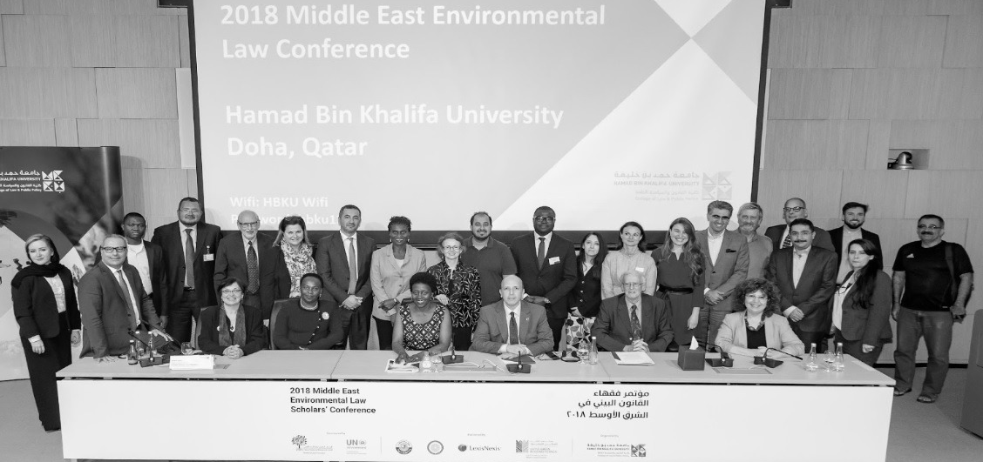
INSIDE HBKU’S COLLEGES:
College of Law
As one of the Gulf’s pre-eminent educational institutions, HBKU’s College of Law (CL)is devoted to preparing a new generation of leaders in the law that is capable of anticipating, identifying, and solving complex problems. Its Juris Doctor (JD) program – the only one of its kind in the MENA region – emphasizes international and comparative law. Two new degree programs, the LLM in International Economic and Business Law and the LLM in International Law and Foreign Affairs, offer advanced, interdisciplinary inquiry on the subject matter. The promotion of the developmental goals of Qatar National Vision 2030 is at the heart of the College of Law’s mission.
Education at the College of Law involves learning in and out of the classroom. Regarding the latter, students have participated in the Philip C. Jessup International Law Moot Court Competition in Washington, D.C. and the Europa Moot Court in Lisbon, Portugal and Athens, Greece. In both, they tested their advocacy skills before international judges and competed against top teams from around the world.
The College of Law is a convener of major events on timely topics. Last year it hosted two international conferences: (1) The Promise of Hybrid Dispute Resolution featuring the former President of the Supreme Court of the United Kingdom, Lord Phillips, and the former Lord Chief Justice of England and Wales, Lord Thomas; and (2) the first Middle East Environmental Law Scholars’ Conference, co-sponsored with the United Nations, which examined how to include environmental law in university curricula. The College of Law also hosted colloquia, including an co-hosted event on targeted political killings with Georgetown University Qatar; a discussion with international law and international relations experts about the implications of the provisional measures order of the International Court
of Justice in the case of Qatar versus United Arab Emirates; and an ambassadors roundtable on international law
and relations in times of turmoil.
Throughout the year, the college welcomed esteemed visitors, including the Attorney General of Montana, Honorable Tim Fox, and the President of the Supreme Court of Paraguay, Honorable Raul Torres Kirmser. Additionally, faculty members traveled the world to speak at prestigious institutions, such as the University of Cape Town, King’s College London, and Yale Law School, and to develop ties with foreign institutions, such as Turkey’s Istanbul Law School.
Anticipated college events for the 2019-2020 academic year include co-sponsoring a follow-on meeting of environmental scholars in Morocco and hosting an international cyber-security moot court and workshop.

Slide 16

INSIDE HBKU’S COLLEGES:
College of Health and Life Sciences
The College of Health and Life Sciences (CHLS) at HBKU offers academic programs in biomedical and biological sciences, genomics, precision medicine, and exercise science. Its educational and research programs integrate knowledge from different areas of biology to establish an environment of research innovation and discovery, and promote an understanding of precision health with all of its facets. CHLS graduate programs are research-intensive and address current and anticipated health challenges.
CHLS programs integrate scientific expertise across an exceptional group of faculty and research partners within the University, as well as with highly valued clinical and health science partners external to HBKU. The excellence of the CHLS programs has driven growth in demand for its MS and PhD degrees in Biomedical and Biological Sciences and in Genomics and Precision Medicine. In May 2018, the college celebrated the successes of 18 graduates, and successfully launched a pioneering Master of Science in Exercise Science degree.
The objective of the training programs at the College is to attract outstanding students from Qatar, the region and around the world. Graduates of CHLS’ programs excel at addressing the needs of the healthcare sector, and continue to contribute to fulfilling the Qatar National Vision 2030. Depending on which area of specialty they opt for, CHLS graduates work to perform basic or applied research in clinical, academic, and industrial fields. Specifically, training in genomics and precision medicine helps them identify genomic variants related to disease to promote translational and precision therapeutics. Exercise science curricula expand on educational and research training to address the global realization that exercise in the form of physical activity is a central factor in sustaining health and preventing disease.
Among other achievements, one of CHLS’ graduates was awarded the 2018 Education Excellence Award by His Highness the Emir, Sheikh Tamim bin Hamad Al-Thani. Additionally, CHLS faculty are internationally recognized and pursue high-impact research in various health-related fields. Research programs often include disease models with an emphasis on the translation of research outcomes to benefit clinical challenges.
The faculty’s recent research successes include the genetic analysis of more than one million people to help identify novel loci for blood pressure, a study which appeared in Nature Genetics. Another study led to the discovery of specific molecular signaling pathways that contribute to senescence and muscle wasting, resulting in multiple publications in EMBO Molecular Medicine. One of CHLS’ current students earned international recognition with the best thesis abstract award at ISSCR 2019.
Today, the College enjoys strong collaborative research ties with public health stakeholders in academia, healthcare, and government. These include HBKU entities such as Qatar Biomedical Research Institute (QBRI) as well as with surrounding schools and research entities in Qatar, such as Weill Cornell Medical School (WCM-Q), Carnegie Mellon Qatar (CMU-Q), Sidra Medicine, and the Qatar Genome Project (QGP).

Slide 17

INSIDE HBKU’S COLLEGES:
College of Public Policy
The College of Public Policy (CPP) – the newest of HBKU’s colleges – was launched in 2019 with its first cohort of students and faculty. The creation of CPP reflects the priority that the university places on supporting and contributing to effective policy development and implementation of the Qatar National Vision 2030.
The College is a unique and exciting environment – a “start-up” that is charged with energy, and open to innovative ideas and experimentation. It is recruiting the best international faculty, building its research capacity, and engaging with Qatar and the global community. CPP aims to be one of the leading public policy schools in the region and the world, acting as a bridge and a hub for innovative policy solutions that contribute to the public good.
The College’s first program – beginning in Fall 2019 – is its flagship Master of Public Policy. The two-year program combines the highest international standards in the field with a distinctive combination of interdisciplinarity, strong ethical foundations, entrepreneurship in public management, and innovation in policy making and design. Students will develop a solid core of theoretical knowledge, and have the opportunity to then specialize in either social policy or in energy and environmental policy. The specializations will be supported by advanced seminars and labs, which culminate in a team-based and client-driven capstone project that addresses a real-world problem.
The growing faculty is committed to supporting the intellectual growth and development of each of its students. CPP demands the most from its students, but demands as much of itself. Theory will be joined with practice, and the College is building partnerships with the wider government, private sector, and research communities to ensure that its students have opportunities to test their knowledge against real world challenges.
The first group of faculty members have rich, diverse, and active research interests, including the ways in which global policy issues are developed, debated, and implemented; food security and trade; the UN’s Sustainable Development Goals; migration in the MENA region; the place of ethics in policy design; effective implementation and program evaluation. Students will be encouraged to conduct advanced research on policy issues when doing their capstone projects, with the objective of contributing to a case study series and policy briefs. In cooperation with its community and government partners, CPP will be establishing research priorities over the coming years that will help inform policy discussions in the country and the region.
The College anticipates several events in the 2019-20 academic year, including a joint workshop on the future of the policy sciences, participation in the Association for Middle Eastern Public Policy and Administration meetings, and hosting several distinguished speakers.

Slide 18
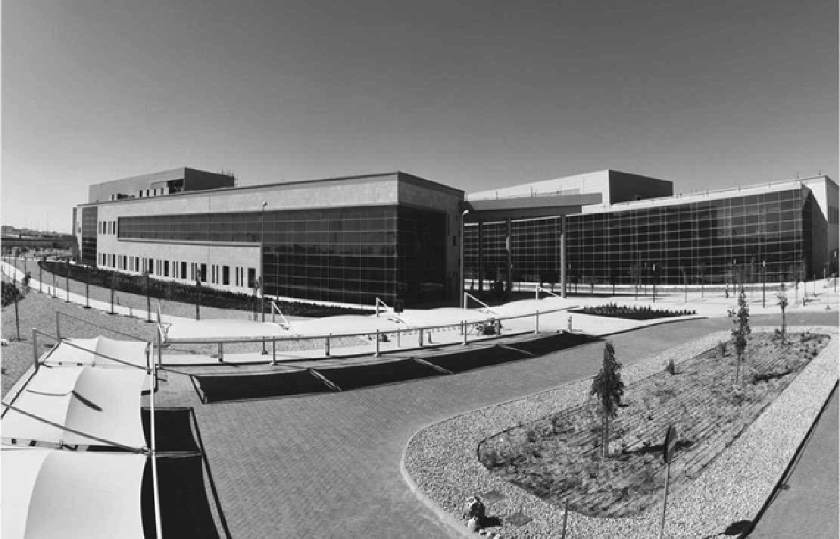
INSIDE HBKU’S RESEARCH INSTITUTES
In line with Qatar National Vision 2030 and Qatar National Research Strategy, scientists
and researchers at HBKU’s three research institutes are at the forefront of shaping Qatar’s innovation and research ecosystem.
Qatar Environment and Energy Research Institute
Addresses national energy and water security grand challenges
Qatar Computing Research Institute
Focuses on large-scale computing challenges
Qatar Biomedical Research Institute
Fosters progressive transformation of healthcare in Qatar and the region

Slide 19
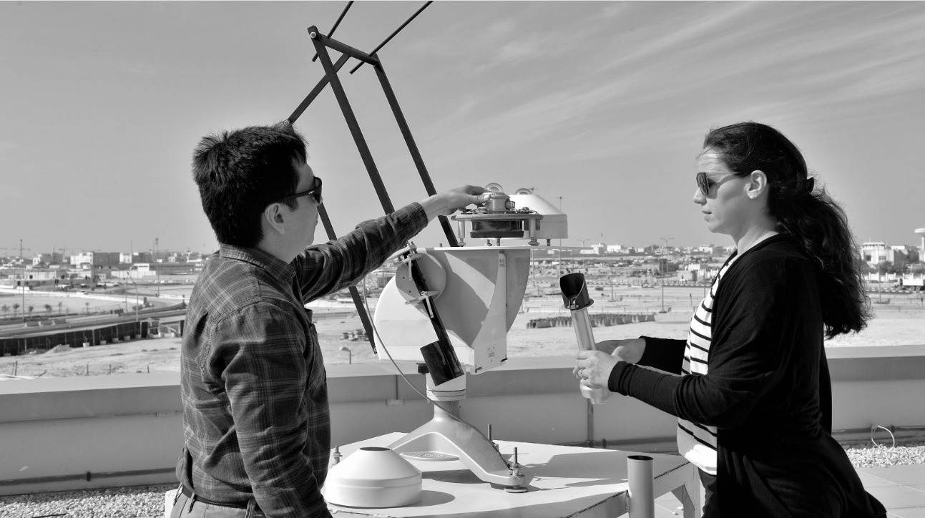
RESEARCH IMPACT STORIES
Qatar Environment and Energy Research Institute
In the last academic year, Qatar Environment and Energy Research Institute (QEERI) has spearheaded a series
of notable research achievements.
Through a collaboration with Qatar Electricity and Water Company (QEWC), launched in 2018, QEERI is developing an advanced Multi Effect Distillation (MED) pilot plant that will serve as a proof of concept for patented ideas that reduce energy consumption and improve energy efficiency of the MED desalination technology.
Together with local farmers in Qatar, QEERI is also working to develop and implement a renewable power system for commercial farming with a special focus on energy, water, and environment. The project aims to build an integrated solar photovoltaic (PV) system to supply the required electrical energy to the farm for irrigation, lighting, and cooling. As part of the pilot project, QEERI has installed a 30kW solar energy system on farms which are part of the pilot phase, and has assessed the water quality of their wells.
As part of its ongoing efforts to promote research, development, and innovation in solar-related technologies within desert climates, QEERI launched the QEERI Solar Consortium in 2018. The membership-based program focuses on research, testing and demonstration of groundbreaking solar-energy technologies.
Notably, in 2018, researchers from QEERI developed an Air Quality Index (AQI) and Inhalable Particulates Index (IPI) for Qatar, which will go on to empower national decision-makers and the general population to make better informed decisions on their personal exposure to the quality of the air we breathe.
QEERI continues to conduct community outreach activities to promote the role of residents in environmental protection. The Science Majlis initiative aims to inform the community about QEERI’s research across energy, water, and environment. Meanwhile, the Student Outreach program teaches young people about renewable energy and their role in sustainability.

Slide 20
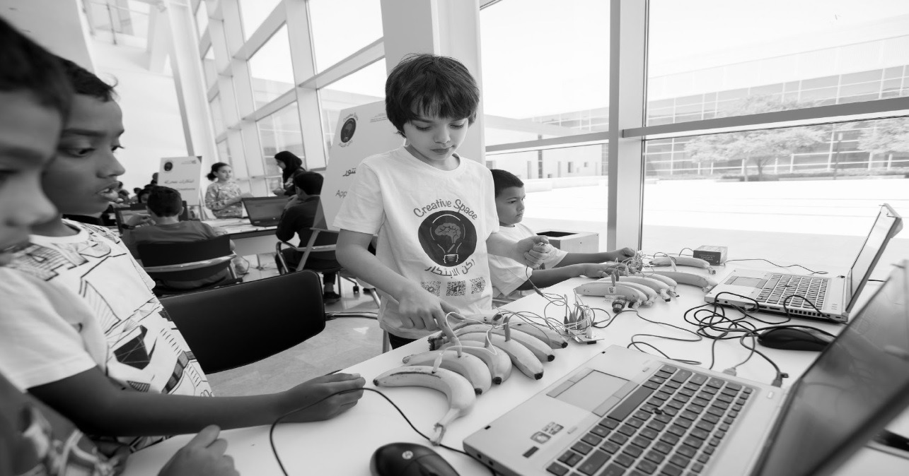
RESEARCH IMPACT STORIES
Qatar Computing Research Institute
Qatar Computing Research Institute (QCRI) plays a pivotal role in diversifying Qatar’s economy and has achieved notable research achievements. In 2018, the Institute’s scientists developed a new algorithm that can identify driver genes of several types of gliomas – the most common and aggressive forms of primary brain tumors. The method was published in the prestigious journals Nucleic Acids Research, and Nature.
During the 72nd United Nations General Assembly session, the institute’s joint research with the University of Oxford and Princeton University – involving Facebook Ad Data to monitor global digital gender gaps – was awarded the Data2X Big Data for Gender Challenge Award by the UN Foundation.
Similarly, at Qatar Foundation’s Annual Research Conference 2018, QCRI was awarded the 2018 Best Innovation Award for its automated transcription and translation system, which is now used by AlJazeera.net and other media powerhouses. The Advanced Transcription System automatically converts speech to text in either English or Arabic using state-of-art speech recognition techniques.
At the same conference, both QCRI and Turkey’s Universal IT Security jointly secured a $US1.65 million grant to develop a defensive cyber intelligence platform for the detection of emerging cyberattacks against enterprises. The grant is one of three revenue partnerships established at QCRI.
To date, QCRI has received more than 140,000 lifetime citations, 850 research papers published in renowned peer-reviewed journals, and filed 258 research patents, of which 41 have been granted. The institute has established three startups with five technologies in the pre-startup phase.
Notably, QCRI further built on its impressive list of international partnerships by renewing existing research collaborations with Massachusetts Institute of Technology’s Computer Science and Artificial Intelligence Laboratory, and embarking on a new collaborative effort by way of a three-year pact with Germany’s Berlin Big Data Center.

Slide 21
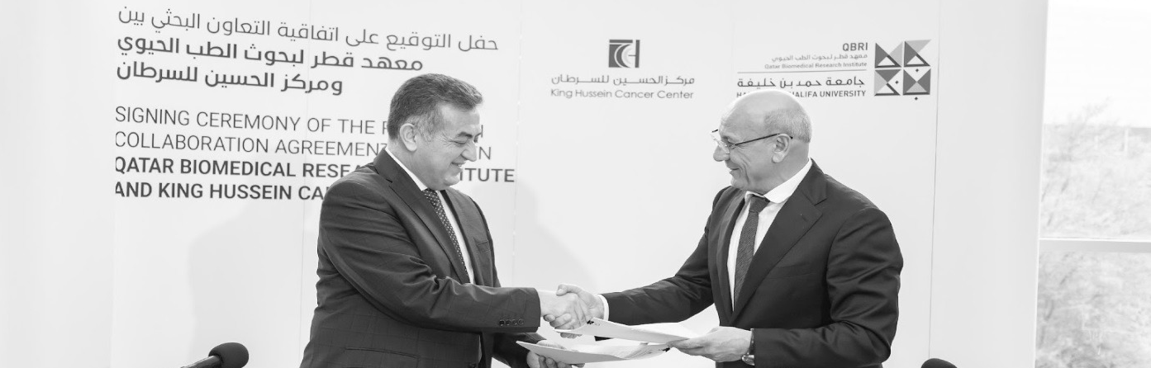
RESEARCH IMPACT STORIES
Qatar Biomedical Research Institute
Qatar Biomedical Research Institute (QBRI) plays an important role in improving and transforming healthcare in Qatar. The institute has witnessed a fruitful year with notable research achievements, including releasing the findings of its intensive six-year study – The Prevalence of Autism Spectrum Disorder in Qatar – the first-of-its-kind study conducted in Qatar and the region. The study’s findings have enabled researchers, in collaboration with the Ministry of Public Health, to create and complete Qatar’s first autism registry. Results of the study have also provided crucial data that will enable the country and its policymakers to work towards adequate healthcare planning and make provisions for specialized healthcare centers.
In line with QBRI’s focus on translational research, it launched the Interdisciplinary Research Programs which stimulates cross-disciplinary research across QBRI’s three research centers (diabetes, cancer, neurological disorders). The program takes into account the complexity of the human body, the combination of diseases a person could be suffering from and looks at finding more holistic biomedical solutions.
Throughout the year, the institute continues to seek opportunities to collaborate with local, regional and international partners, to improve healthcare in Qatar and achieve personalized medicine. Among the newly established strategic partnerships is the five-year research and training agreement with Harvard Stem Cell Institute (HSCI) focused on diabetes and stem cell biology. The collaboration has already begun at HSCI, where QBRI staff are exchanging knowledge and best practices and helping to accelerate the ultimate goal of translating discoveries into clinical trials and applications, thereby supporting groundbreaking research. Working towards accelerating cancer research in the region, QBRI signed impactful research agreement with King Hussain Cancer Center in Jordan which will allow each institution to benefit from complementary research assets and immediate access to different populations.
These are in addition to existing partnerships with Hamad Medical Corporation, Cleveland Clinic, Shafallah Center, AFFIRIS and Lundbeck. The institute celebrated research innovation through the achievement of young and talented QBRI researcher, Nour Majbour, who successfully secured second place in Stars of Science, a popular reality TV show initiated by Qatar Foundation. Majbour’s innovation, a Parkinson’s Early Detection Kit, could potentially advance future diagnostics of the neurodegenerative disease.
QBRI’s commitment to capacity building was exemplified in the last academic year. Its Research Fellow Program has successfully attracted outstanding Qatari PhD holders from internationally renowned universities, who are then given the training, mentorship, and guidance to become the country’s next generation of independent researchers. In addition, a number of the institute’s scientists hold prominent academic roles and responsibilities at HBKU, where they mentor an increasing number of MSc and PhD students. Similarly, the QBRI’s Summer Research Program brought together outstanding students, who gained hands-on laboratory experience alongside distinguished mentors. The community plays an integral role in the research process. QBRI have remarkable interaction with the public through various awareness campaigns, such as on diabetes, breast cancer, Alzheimer’s or autism.

Slide 22
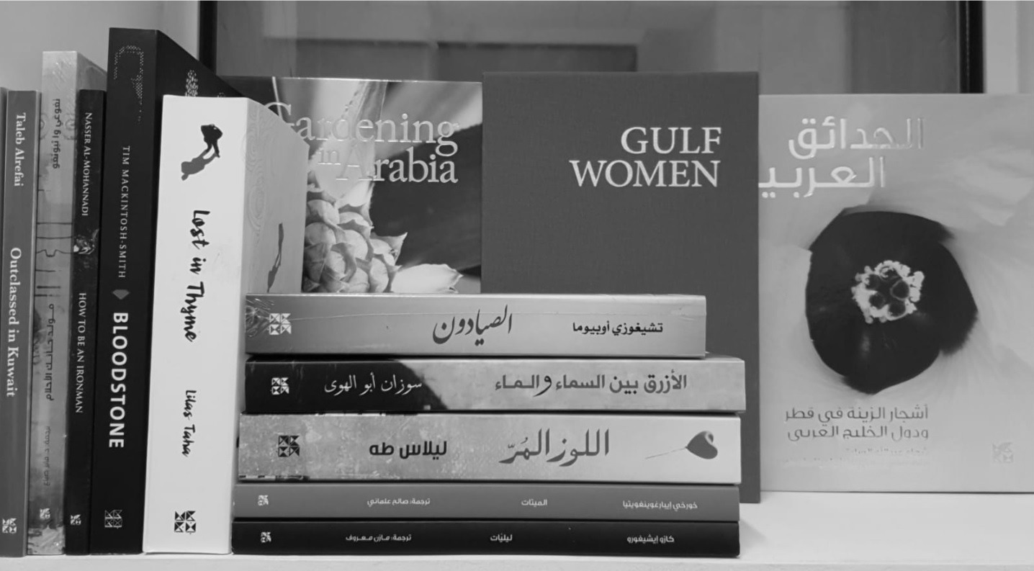
HBKU PRESS
Hamad Bin Khalifa University Press (HBKU Press) was launched in 2010 as a world-class publishing house founded on international best practices, excellence, and innovation. Headquartered in Doha, Qatar, HBKU Press publishes fiction and non-fiction titles for adults and children, and academic and reference materials. HBKU Press aims to promote a love of reading and writing by helping to establish a vibrant scholarly and literary culture in Qatar and the Middle East.
HBKU Press:
Fosters, supports, and highlights Qatari and regional academics, authors, illustrators, and translators by acting as a dedicated platform for academic and trade publishing where Arab talents are propagated in the Gulf region and beyond.
Encourages and supports their talents throughout the creative writing process to produce quality academic, non-fiction and fiction works of a high caliber.
Provides an Open Access academic publishing platform with Creative Commons licensing to ensure that the author is at the heart of the editorial process.
Is committed to serving the wider community through various outreach programs.

Slide 23
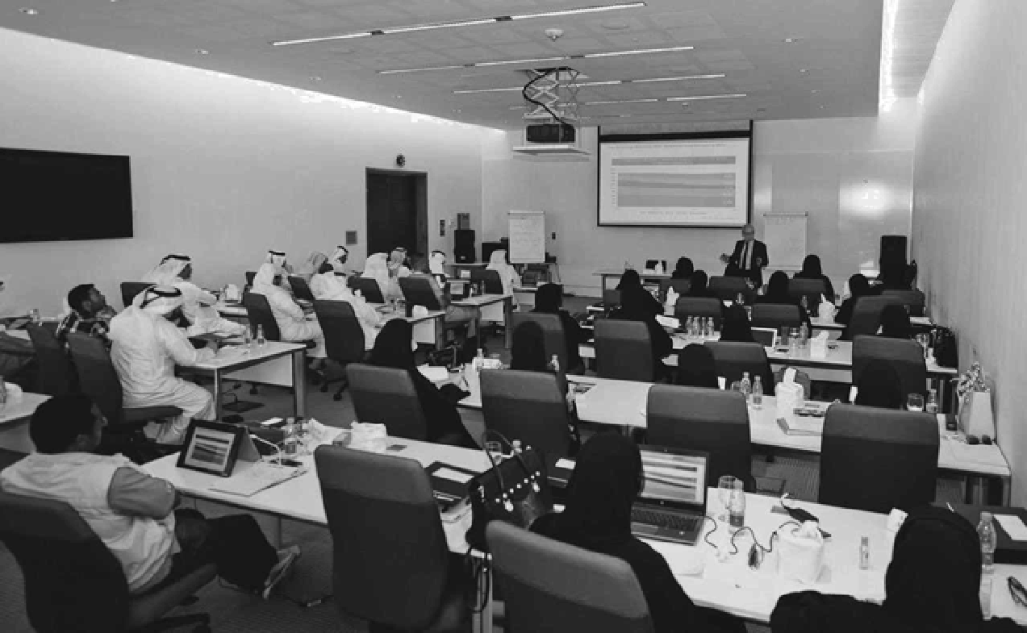
EXECUTIVE EDUCATION CENTER
HBKU EEC’s mission is to contribute to the Qatari community by:
Providing life-long learning and educational opportunities
Supporting training needs and programs linked to Qatar’s economic diversification goals

Slide 24
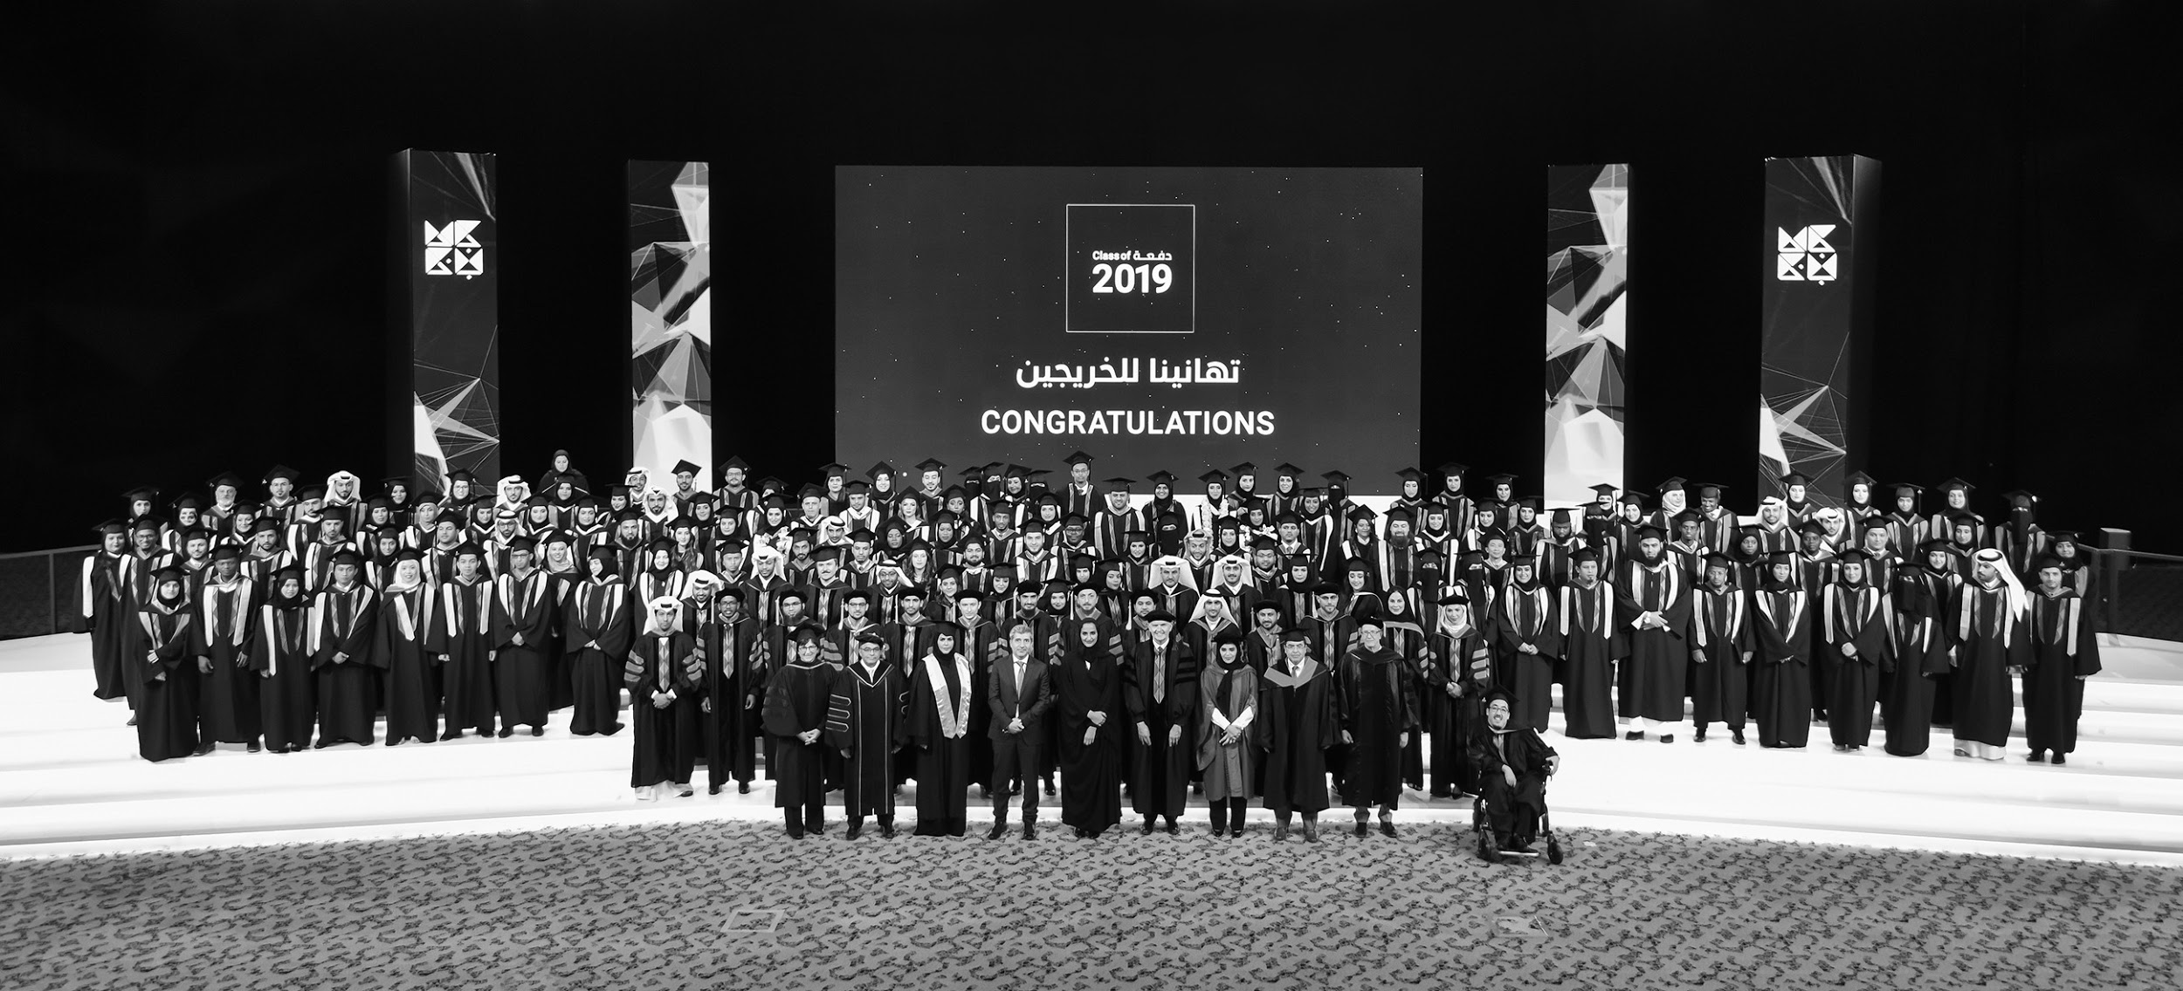
AT A GLANCE
Number of programs: 36
Graduate programs: 35
Undergraduate programs: 1
Females enrolled:: 55%
Males enrolled: 45%
Qatari students: 34%
Non-Qatari students : 66%
Alumni: 900+
Total number of employees: 670+
Faculty: 75+
Researchers: 350+

